Slide 1
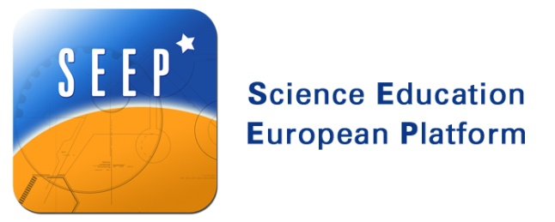
Creative ways in the classroom that inspire students towards a science career
Tatiana Marandici
President of Asociatia Pro Educatie si Formare and
Physics teacher at Mircea cel Batran College
Ramnicu Valcea, Romania

Slide 2
Developing and nurturing creativity and innovation is essential for students today more than ever!
With the issues that will face them — climate change, overpopulation, shrinking natural resources, to name just a few — these skills will be critical as tomorrow’s leaders formulate solutions.
In the context of technology advances and increases on a daily basis, the companies will need employers who can come up with new types of technology and new ways to use them.
Those future skills will be built on what students do in the classroom today!

Slide 3
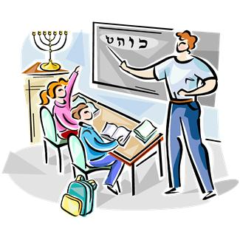
How can I make more attractive science to my students ?

Slide 4
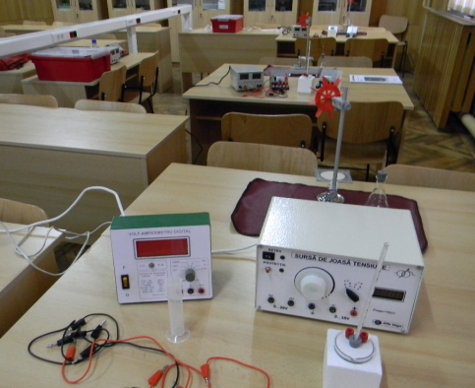
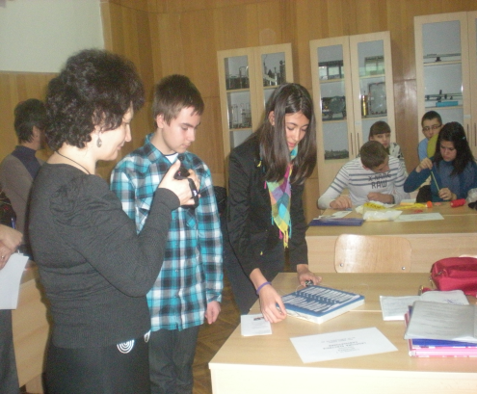
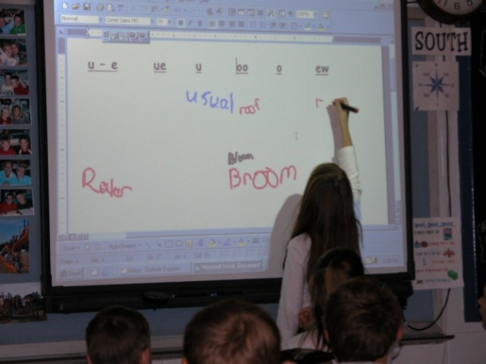
It is necessary that traditional methods of teaching to be
supplemented with
creative activities
One of the simplest ways to get creative in the classroom is to use multimedia materials. Technology becomes a tool, supporting the learning process as students seek new knowledge and understanding

Slide 5
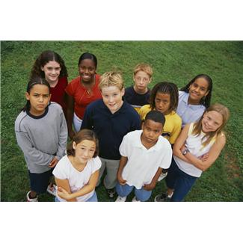
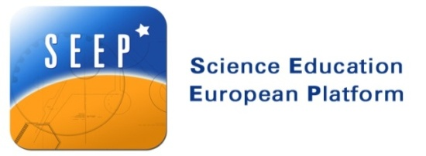
Students who are interested in school science or think that school science is relevant in everyday life would like more creative activities such as brainstorming and project work.
What Is PBL?
In Project Based Learning (PBL), students go through an extended process of inquiry in response to a complex question, problem, or challenge.
Projects help students learn key academic content and practice 21st Century Skills (such as collaboration, communication & critical thinking).
http://www.youtube.com/watch?v=VgA1wZhW5TE&feature=related -

Slide 6
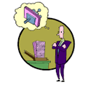
Teachers in a project-based science classroom, act as facilitators, mentors, resource persons, advisers, scientists, listeners, learners and leaders in the science classroom. They work with students to identify projects that they are interested in and create learning environments that allow them to gather resources, plan, implement, evaluate and report on their projects.
Students decide what to learn, how to learn, the time required to learn, and how to document and report their own learning.

Slide 7
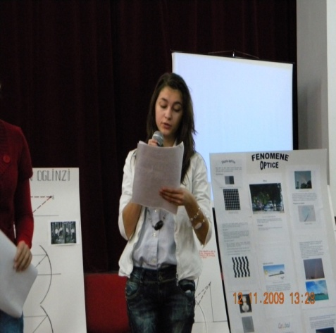
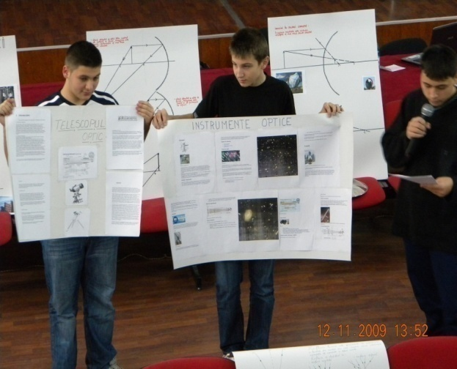
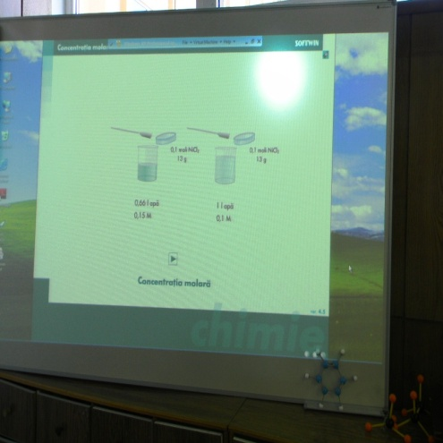
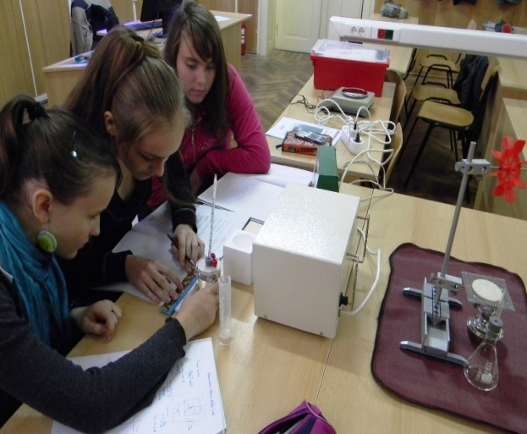
PBL requires students to conduct extended projects, which means sometimes doing work outside of school.
For each presentation the students used posters, experiments or PPT presentation

Slide 8
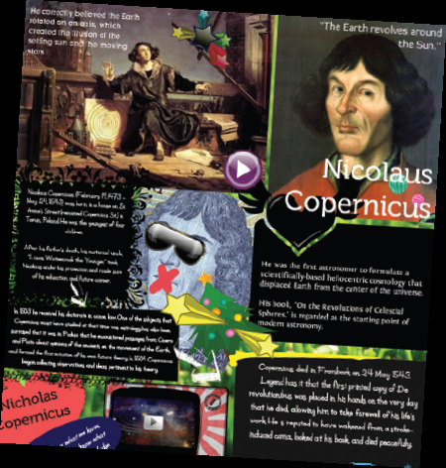
Creating Glogster !
Students loved to demonstrate their knowledge and skills in the interactive lesson using Glogster EDU.
The students work in groups using the Glogster website to create online posters that can be added to the classroom website and printed, if it necessary.
Glogster can also be used as a demonstration tool !
http://vvlad.glogster.com/vlad/
http://ancamaria.edu.glogster.com/dispersia-luminii/

Slide 9
Thank you for
your attention!

